Slide 1
NEST Lancashire’s Domestic Abuse Project Status Update
Rowan Cleet Senior Young Person’s Domestic Abuse Practitioner

Slide 2
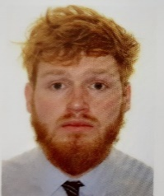
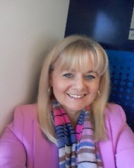
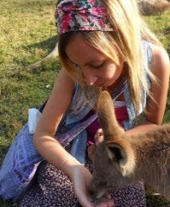
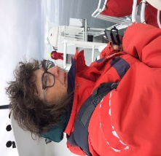
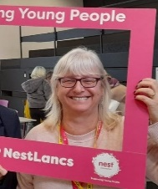
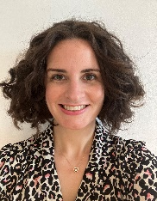
The Team
Rowan Cleet - Senior Domestic Abuse Practitioner
Karen Thomas - Domestic Abuse Practitioner
Emma Robinson - Domestic Abuse Practitioner
Wendy Fisher-Hetherington - Domestic Abuse Practitioner
Mandy Crossley - Domestic Abuse Practitioner
Laura Henderson – Domestic Abuse Practitioner
Rowan Cleet
Karen Thomas
East Lancashire
Emma Robinson
East Lancashire
Wendy Fisher-Hetherington
South Lancashire
Mandy Crossley
South Lancashire
Laura Henderson
North Lancashire

Slide 3
Common barriers for CYP’s engagement with support
Acknowledged Impacts of witnessing DA
Emotional and psychological wellbeing
Victim Support identified:
School performance
Relationship with family and friends
Lack of insight into impact of witnessing DA
Timing and method of providing support by support services
Victim Support identified:
Lack of knowledge about DA services
Ania Moroz (2021). Restoring trust: children witnessing domestic abuse. [Online]. Available at: https://www.victimsupport.org.uk/wp-content/uploads/2021/10/Restoring_Trust_external-report.pdf. Accessed 29 July 2022.

Slide 4
What do we do:
Engage: to bring together and involve.
Enable: Give permission or the right to do it.
Empower: to give authority or control.
Work to empower victims and witnesses of crime to enable them to cope and recover.
Increase understanding of the impact of witnessing DA on CYP
Increase understanding of any barriers to engagement with support services and respond.
Explore and increase the understanding of CYP’s support needs and provide learnings as to what help will enable them to cope with the effects of witnessing the abuse and recover as much as possible.

Slide 5
How we do it:
Session One - Introductions:
Program Induction
What is Domestic Abuse?
What is the Power and Control Wheel?
Session Two - Rights and Responsibilities:
What are my Right and Responsibilities in Relationships?
What Happens and who can Help When my Rights are Denied?
What is the Victim’s Code of Practice?
Session Three - My Safety Net:
What is Safety in a Relationship?
How can I keep Safe from an Abusive Person?
Session Four - Self-Esteem:
How Might an Abusive Person Damage Self-Esteem?
How Can we Improve Self-Esteem following Domestic Abuse?
Session Five: Healthy Relationships and Trust:
How Should I be treated in a Non-Abusive Relationship?
Session Six: How to Handle Difficult Feelings:
How Can I manage Challenging Emotions?
Celebration

Slide 6
Overview – October 2021 till July 2022:
Number of groups delivered - 56
Number of children reached (assessed) – 276
Number of children to complete the program 187 (68%)
Delivered the program in 46 schools
Targeted School 68

Slide 7
Overview - Q1 April 2022 till June 2022:
Number of groups started - 22
Number of children reached (assessed) - 67
Number of children to complete the program - 58 (86%)
Delivered the program in 21 schools

Slide 8
Outcomes April to June
 | Improved | No change | Deteriorated | Number of responses
1. How would you describe your knowledge and understanding of Domestic Abuse? | 57 | 1 | 0 | 58
2. How would you describe your level of confidence in asking for help around Domestic Abuse? | 51 | 7 | 0 | 58
3. How would you describe your knowledge around your rights in relationships? | 54 | 4 | 0 | 58
4. How confident do feel keeping yourself safe from Domestic Abuse at home, at school and in the community? | 55 | 3 | 0 | 58
5. How would you describe your knowledge around the impact of Domestic Abuse on emotional wellbeing? | 53 | 5 | 0 | 58
6. How would you describe your knowledge of what makes a healthy relationship? | 56 | 2 | 0 | 58
7. How would you describe your confidence in managing challenging emotions? | 55 | 3 | 0 | 58
 | Average start score | Average final score | Distance travelled
1. How would you describe your knowledge and understanding of Domestic Abuse? | 1.81 | 3.55 | 1.74
2. How would you describe your level of confidence in asking for help around Domestic Abuse? | 1.81 | 3.29 | 1.48
3. How would you describe your knowledge around your rights in relationships? | 1.72 | 3.52 | 1.79
4. How confident do feel keeping yourself safe from Domestic Abuse at home, at school and in the community? | 1.97 | 3.59 | 1.62
5. How would you describe your knowledge around the impact of Domestic Abuse on emotional wellbeing? | 2.00 | 3.66 | 1.66
6. How would you describe your knowledge of what makes a healthy relationship? | 1.98 | 3.64 | 1.66
7. How would you describe your confidence in managing challenging emotions? | 1.59 | 3.50 | 1.91

Slide 9
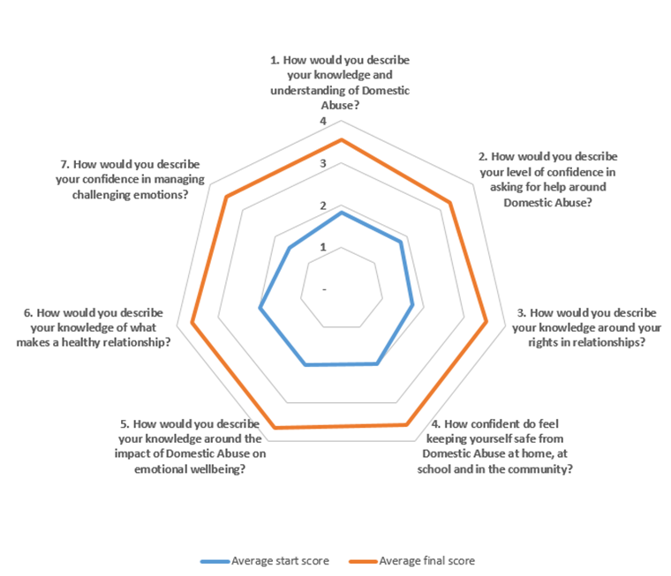
Outcomes April to June

Slide 10
Young Person’s Review:
`It been helpful speaking to someone and that I spoke to you and you sorted out me moving to Ap (schools alternative provision) instead of being kicked out of school`.
I have learnt and remember the number for silent solution. I know my rights and I liked coming to the group it was really fun and enjoyed the games.
`How to manage abusive relationships and how to find help if needed`.
`I have found feeling safe more useful and to make sure to tell someone how I feel because if I don’t it will all be bottled up and explode I have also become better at managing my anger`.
`The safety was the most useful` / `I am more confident with my right and wrong` / `someone has helped me with my anger and rights`.
`Yes because now I know what my rights are and its helped me with my whole life`
I know what domestic abuse is now and I never used to go to anyone and was just getting used to [teacher] I have a good relationship with her after this and can use her in school to talk about things.
`Just understanding and talking about what happened` / `Yeah I feel calmer and know that support isn't bad and there are actually sound people who get it`.
`Mum trying to off herself and how dad has treated me and being able to accept it and get help`.
`Made me look forward to coming to school`.

Slide 11
Schools Review:
`I have found Emma to be approachable and flexible where needed she has a really positive relationship with the YP and it is clear that they feel at ease in the sessions` Teacher - East Lancashire.
`Speaking with the students individually each said they were happy to have taken part and feel they are now better equipped to move forward. Those who took part would not normally spend time in each other's company but through completing the course realized they were able to engage with others out of their circle of friends. It showed them we are not alone in dealing with upsetting situations but that we can get along with the least likely of people and support each other through difficult times` Teacher - North Lancashire.
`I think all of the children who have come to this have gained something from it individually. Especially like the Passive, Aggressive assertive, they don’t always understand that being passive can lead to them being taken for granted and I know if I had had that session when I was younger it would have shaped me completely differently whilst growing up` Teacher - East Lancashire.

Slide 12
Volunteer Review:
As a VS Volunteer, I have just completed my first NEST programme delivered [in an East Lancashire School] by Emma Robinson. I believed that my role was to support Emma in any way that was appropriate, and to learn from the experience to make myself increasingly useful to NEST in the future! I was very fortunate to be paired up with Emma; she is brilliant with the young people.
Initially, I did have a few reservations about the project. For a start, I didn’t like the idea of siblings being in the same group. In my experience, older siblings have a tendency to inhibit or undermine younger ones. I was also unsure about the mix of ages, and the very short length of the programme.
However, I was truly amazed by the distance covered from the first to the last of these sessions. In the early weeks, the group was quiet and subdued. Emma steadily drew out each child using a range of activities based on a weekly theme. This was done with humour and empathy. It was very evident that the children quickly came to value this time and space where they were not judged and where they clearly felt comfortable with us.
Observing more than delivering, I was able to see the very real changes in body language and confidence. By the end, friendships within the group were formed, and the atmosphere was entirely different to the first few sessions with smiles and laughter becoming the norm. I know that their problems remain the same but the programme went further than I had imagined possible in helping these young people to develop coping skills.

Slide 13
Next
We are collecting referrals now for September start.
Over the summer the team will assess and allocate cases.
Engaging Faith and Private schools to increase delivery of the program on the new academic year.
Consulting with young people around these outcomes and our good to great focus.
Remaining committed to all our secondary settings and promoting the program via our news letter and regular contact.

Slide 14
Any questions please contact me direct,

